Slide 1




Credit Loan
Classification
Virtual Experience Project-Based Internship
at ID/X Partners - Data Scientist
Hosted By:
Intan Citra Phonskaningtyas

Slide 2

SHORT BRIEF
Project
Overview
What is Credit Loan Risk Classification?
Credit Loan Risk Classification involves evaluating the likelihood of a borrower defaulting on a loan, be it ‘bad loan’ or ‘good loan’. It utilizes statistical models and machine learning algorithms to categorize borrowers into risk groups, aiding financial institutions in making informed lending decisions.
Why is it important?
Risk classification is crucial in lending as it helps financial institutions identify and manage potential risks associated with loans. By categorizing borrowers based on their creditworthiness, lenders can optimize interest rates, set appropriate terms, and minimize the likelihood of defaults, thereby safeguarding their financial health.

Slide 3

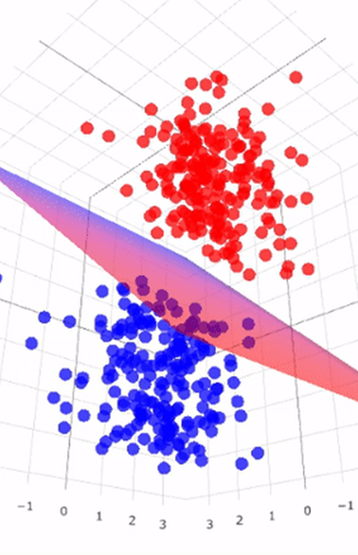
PROJECT
Methodology
In this project, the Support Vector Machines (SVM) model is deliberately chosen for its exceptional efficacy in categorizing data into precise risk categories.
Its robust predictive capabilities make SVM a reliable tool for accurate credit loan risk assessment, ensuring a nuanced understanding of borrower risk profiles and enhancing the overall decision-making process in lending.

Slide 4















Resource
Page
Use these design resources in your Presentation. Happy designing!
Delete or hide this page before presenting.

Slide 5
Data
Wrangling

Slide 6
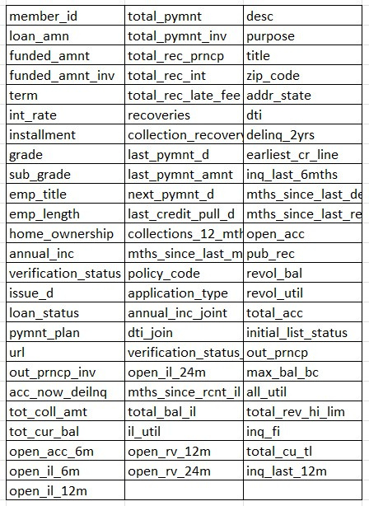
DATA WRANGLING
Dataset
Overview
Dataset Source
The dataset, essential for the final project, is graciously provided by ID/X Partners, offering valuable insights into various aspects of loan data from 2007-2014.
Dataset Source
The dataset encompasses a diverse set of features crucial for the analysis, including member_id, loan amount details, interest rates, employment information, credit history, payment status, and various financial indicators. These features collectively form the foundation for this credit loan risk classification project.

Slide 7
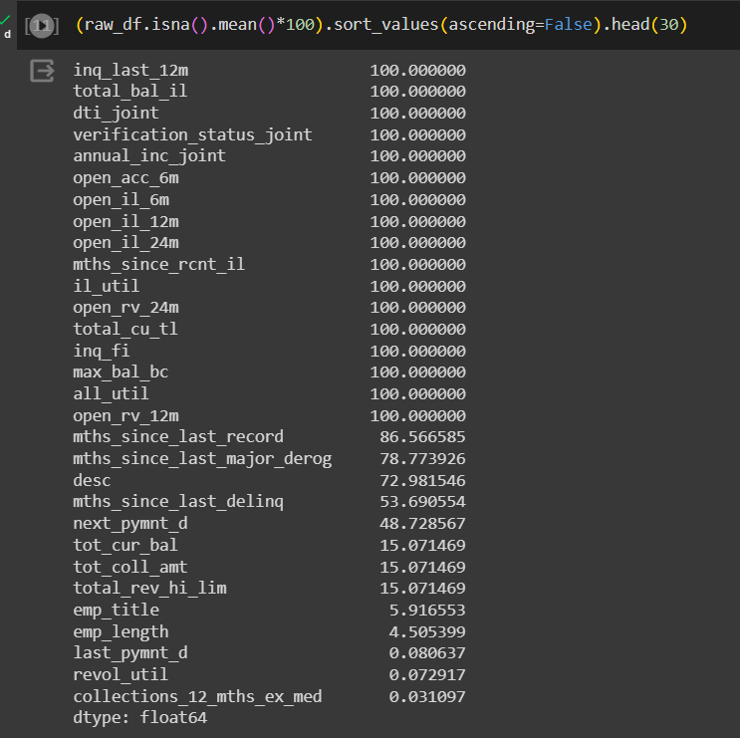
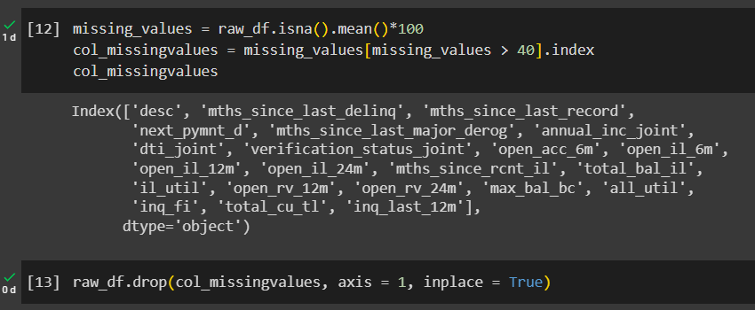


Assess the missing values in dataset using percentages.
Remove columns with more than 40% or nearly half of the column entries which contain missing values.

Slide 8
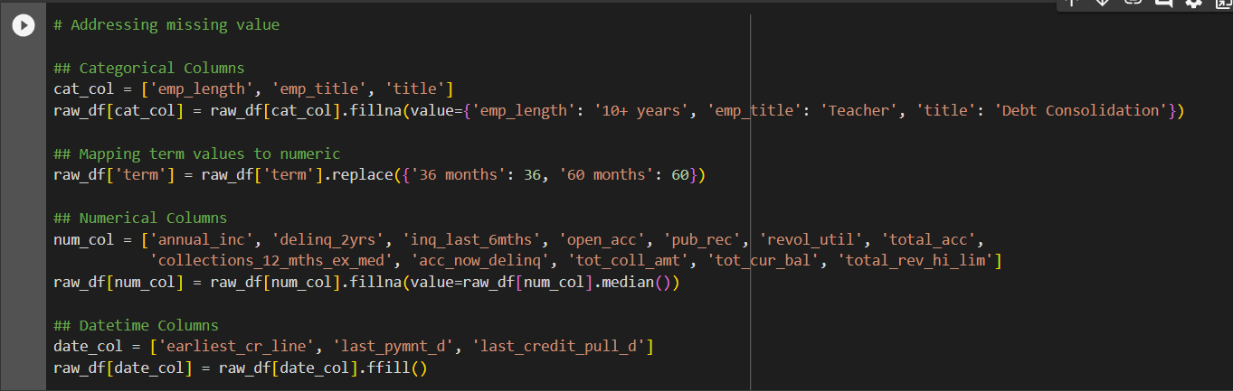
Handling missing values involves imputation for all data types, encompassing categorical, numerical, and datetime variables.

Slide 9
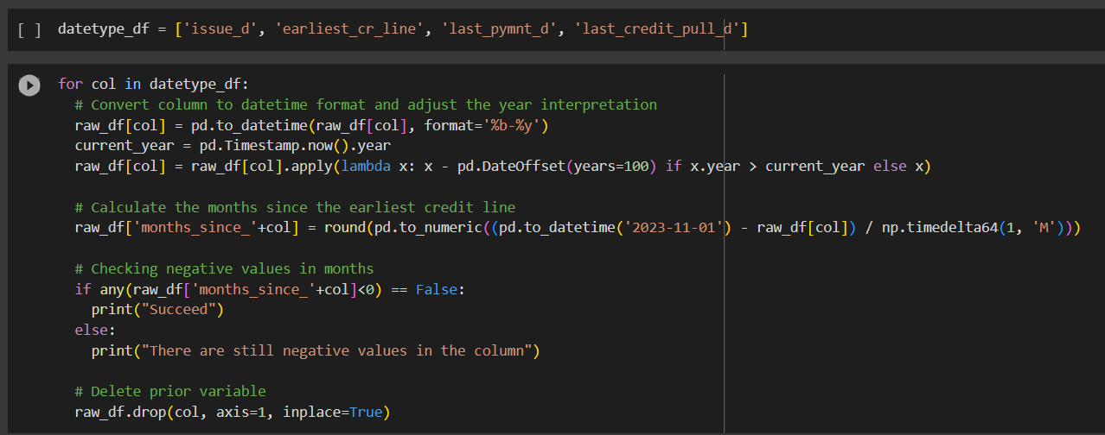
Convert the datetime variables into the number of months elapsed since the respective dates until November 1, 2023.

Slide 10
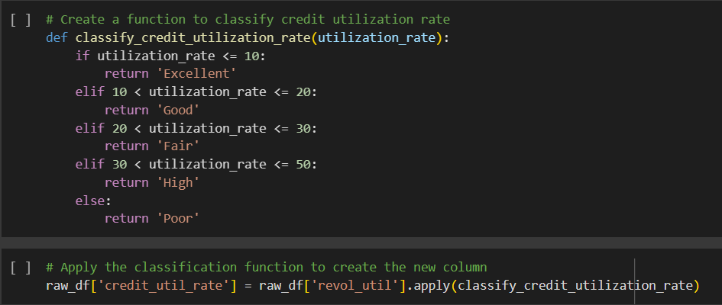
Classify the Revolving Line Utilization Rate, representing the borrower's credit usage relative to all available revolving credit, into five categories: "Excellent," "Good," "Fair," "High," and "Poor."

Slide 11
Eliminate categorical variables with an excessive number of categories and numerical variables with unique values across the entire dataset.

Slide 12
Exploratory
Data Analysis

Slide 13
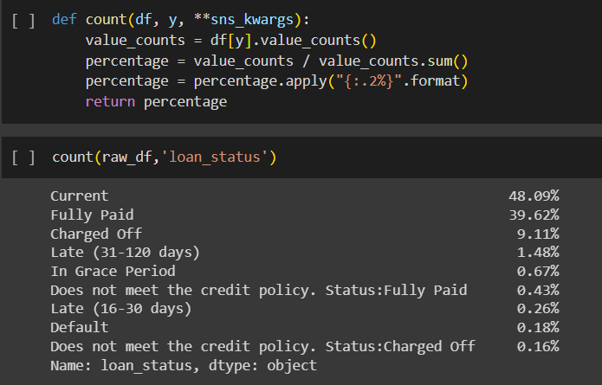
Loan Status Categorizing
Count Values for Each Categories
Based on the loan status categories provided, loans are commonly categorized as either "good" or "bad" based on their repayment status.
Good Loans: “Current”, “Fully Paid”, “Does not meet the credit policy. Status:Fully Paid”
Bad Loans: “Charged Off”, “Late (31-120 days)”, “In Grace Period”, “Late (16-30 days)”, “Default”, “Does not meet the credit policy. Status:Charged Off”

Slide 14
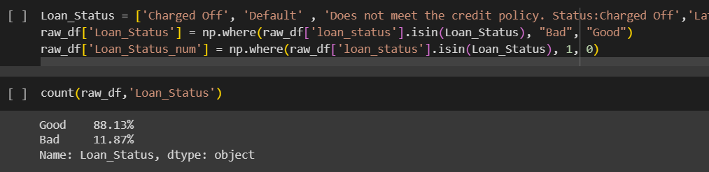
Loan Status Categorizing
Categorize the Values
The loan_status is categorized into two categories, which are “Good” and “Bad”. As for the numerical variables, it categorized into 1 for “Bad” and 0 for “Good”

Slide 15
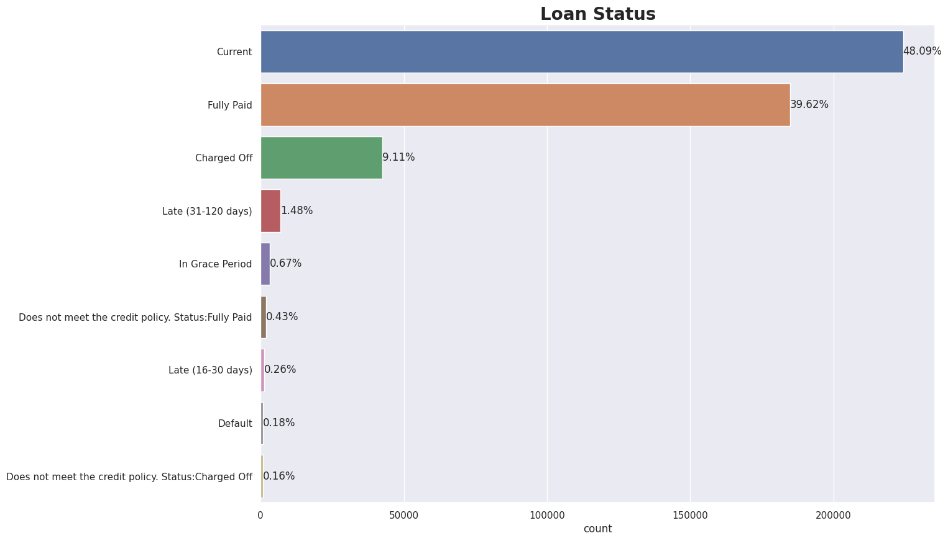
Loan Status
The majority of loans are in the "Current" status. In terms of success, loans that are successfully repaid have a higher ratio compared to those that are overdue.

Slide 16
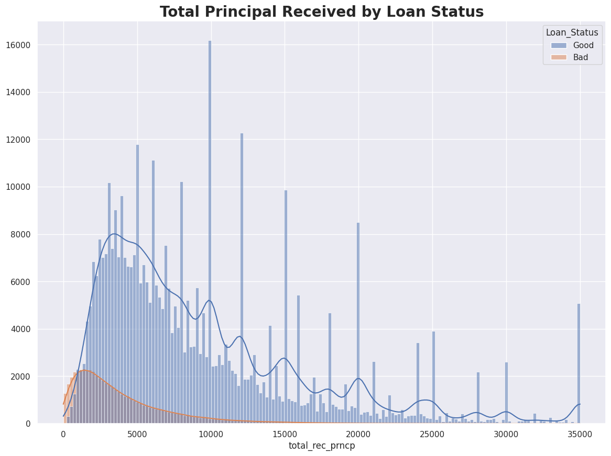
Total Principal Received by Loan Status
The term "Principal" refers to the principal amount of the loan extended to the borrower. In other words, it is the original sum of money borrowed.
Majority of the "Bad Loan" often struggle to repay the principal amount by the due date, as evident from the distribution of payments showed.

Slide 17
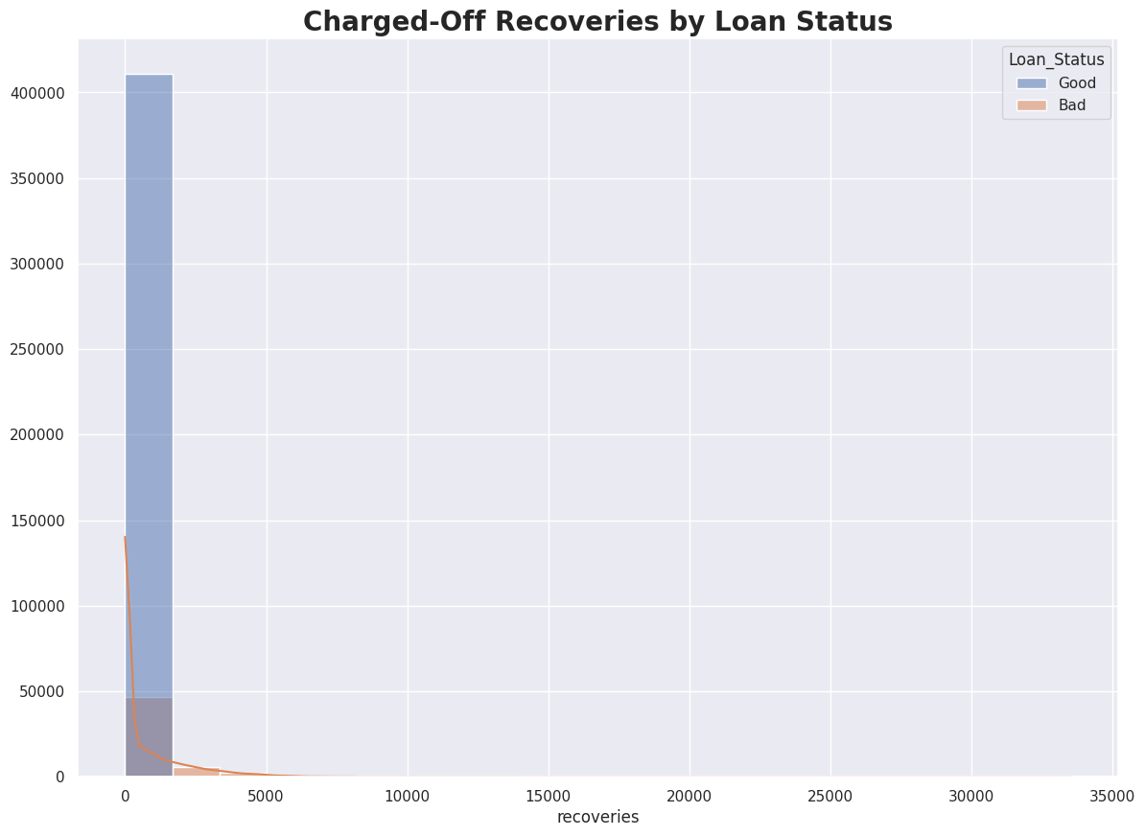
Charged Off Recoveries by Loan Status
Charged-off loan recoveries represent the uncollectible total after the due date.
Borrowers may sell the debt to another company, indicating that individuals with poor loan statuses primarily face charged-off recoveries.

Slide 18
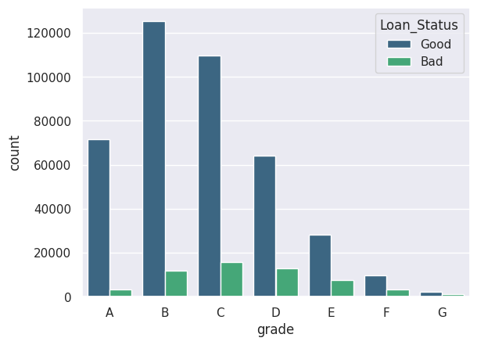
Grade by Loan Status
Most borrowers fall within the B, C, and D grades.
However, those with a Bad Loan Status tend to have an average grade of C-D, highlighting a contrast with the Good Loan Status borrowers who, on average, hold a B-C grade.

Slide 19
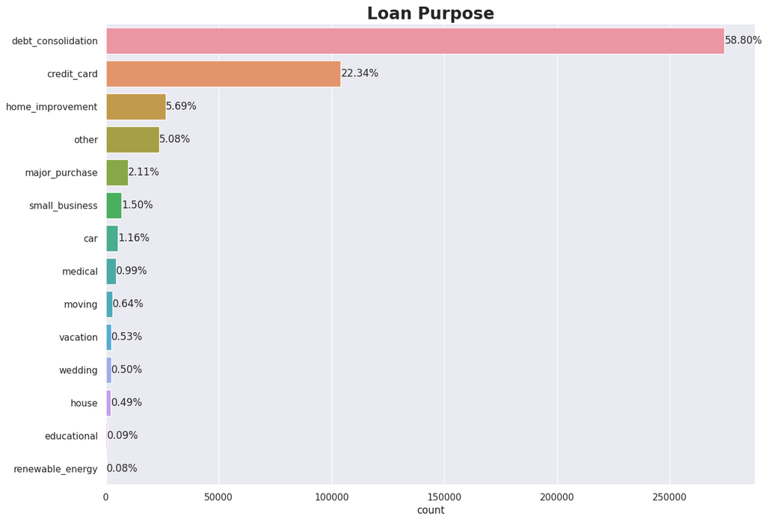
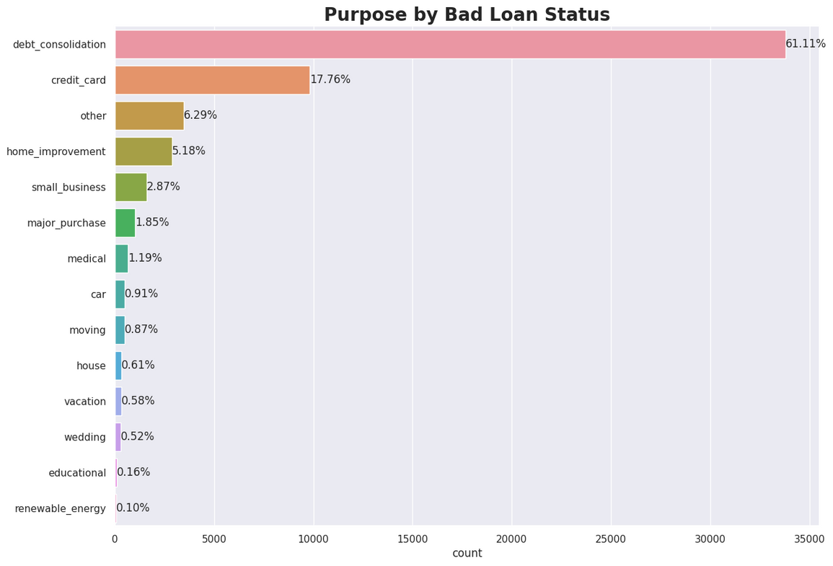
Loan Purpose
Over 50% of borrowers sought loans for debt consolidation, with common purposes including credit card repayment, home improvement, unspecified reasons, and major purchases.
Interestingly, even among those with a Bad Loan Status, over 50% similarly chose debt consolidation as their primary loan purpose.

Slide 20
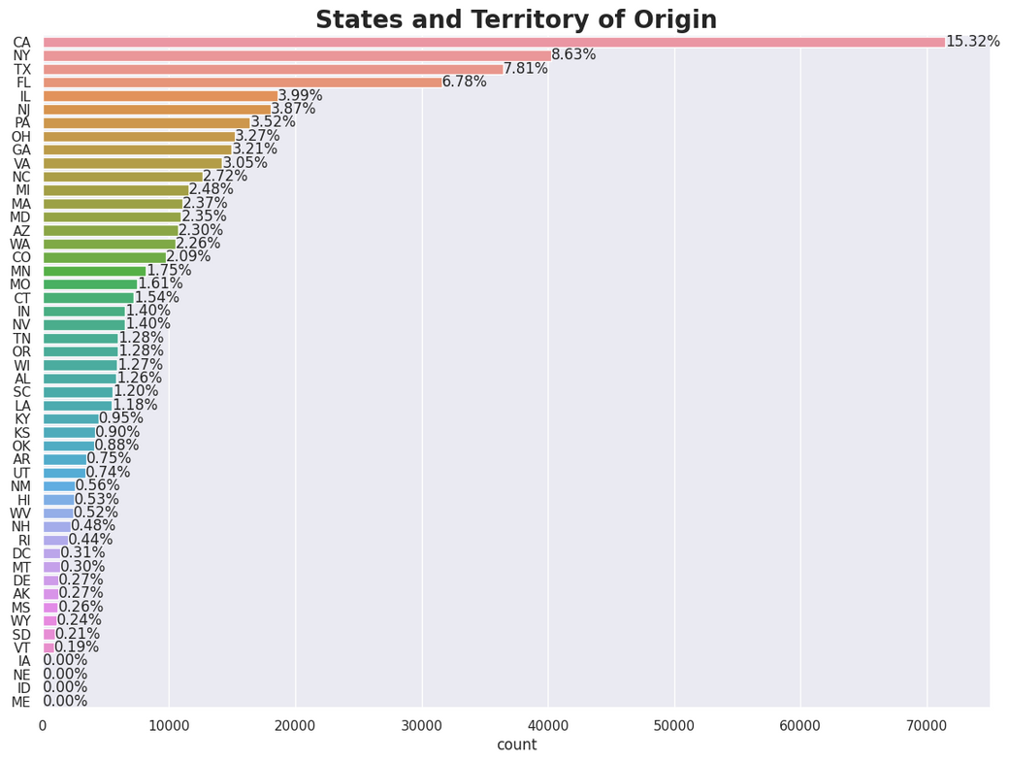
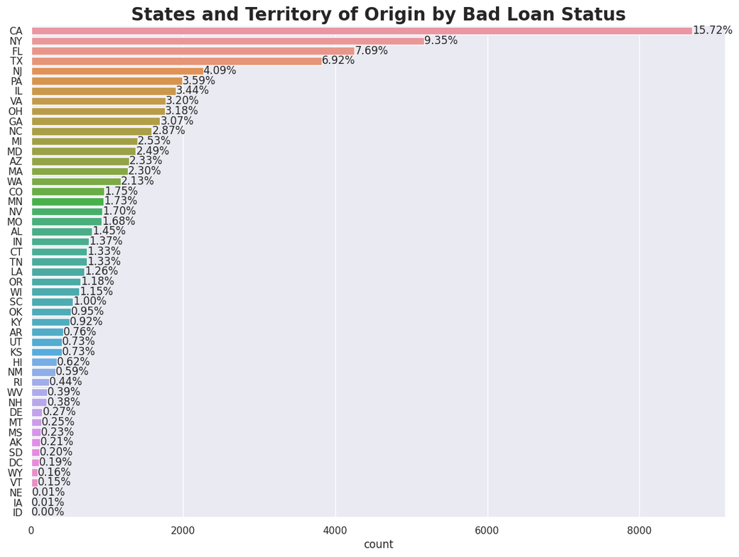
State and Territory of Origin
These two graphs highlight the dominant states and territories of origin for borrowers in taking out loans.
Overall, and specifically among those with a Bad Loan Status, California led with 15%, followed by New York.

Slide 21
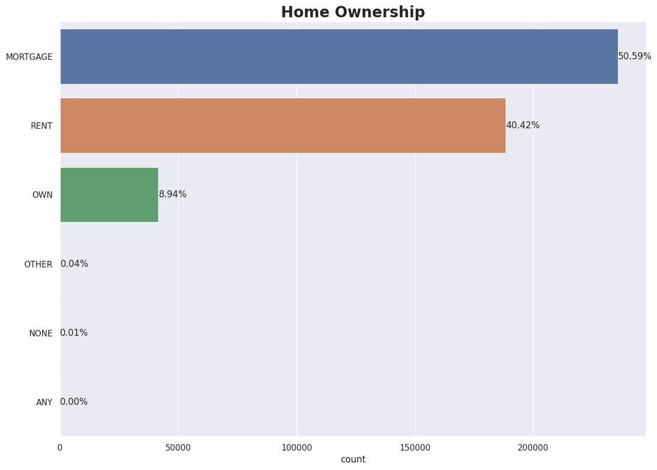
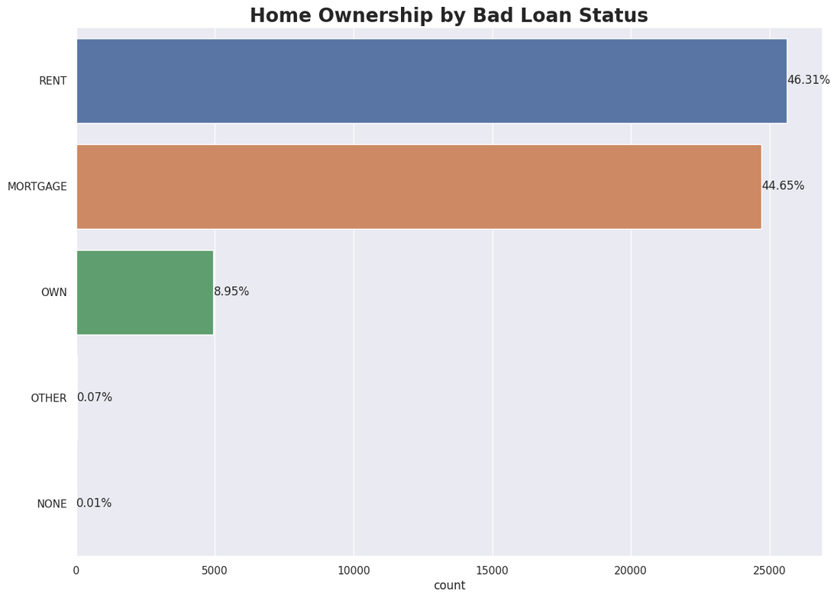
Home Ownership
The borrowers' home ownership is defined by their housing arrangements.
Overall, the majority opt for mortgages, with rent being the second most common. Interestingly, for those with a Bad Loan Status, the majority prefer renting, in contrast to the overall trend.
This divergence underscores distinct housing choices between borrowers with varying loan statuses.

Slide 22
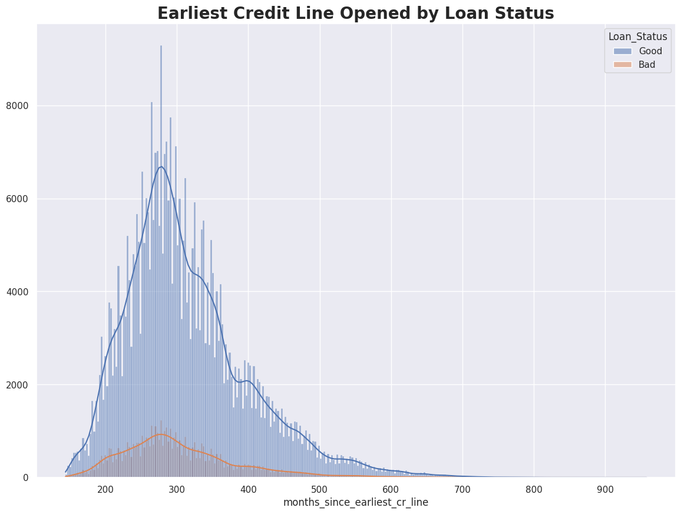
Home Ownership
The earliest credit line for borrowers indicates the inception of their credit history. Interestingly, the distribution for both good and bad loans is right-skewed, with modes clustered between 250-280.
While good loans suggest a hint of multimodality, the overall similarities in the right-skewed pattern underscore some commonalities, with nuanced differences between the two loan categories.

Slide 23
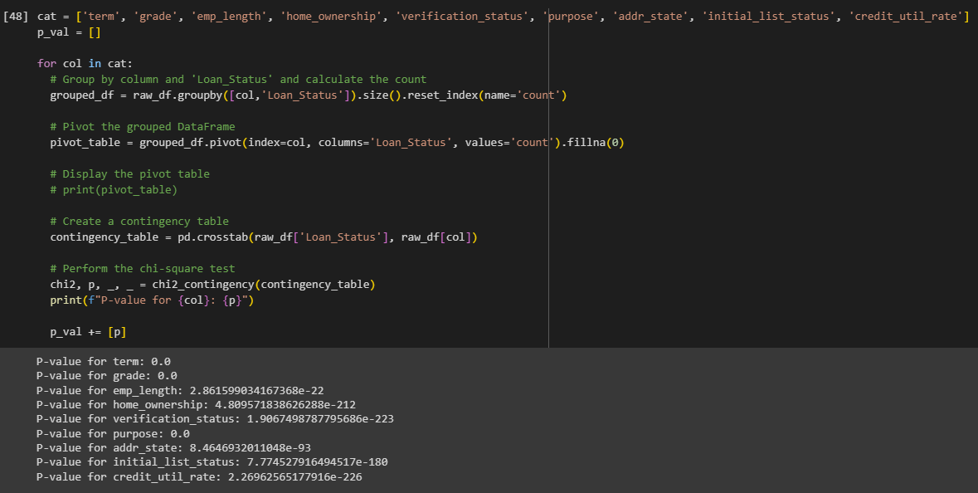
Loan Status with Categorical Variables
These numbers show that every categorical variables has significant association with Loan Status and can be used in the model to predict Loan Status.

Slide 24
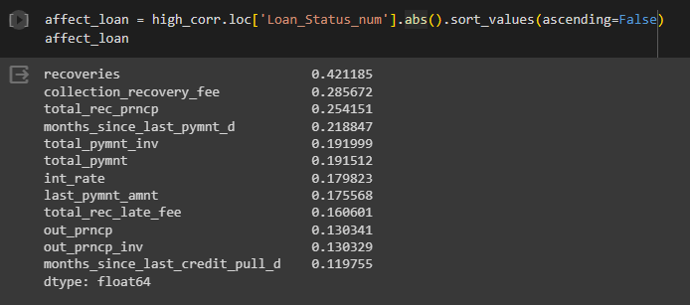
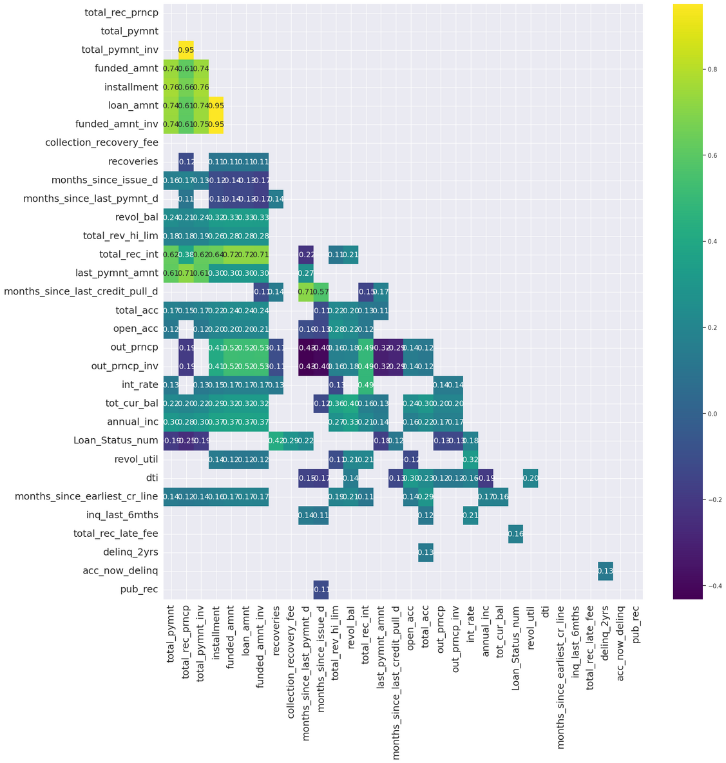
These numbers shows the best numerical variables that have the significant correlation with Loan Status and can be used in the model to predict Loan Status.
The variables chosen have correlation between 0.1 and 0.99.

Slide 25
Preprocessing
Data
For Machine Learning Modelling

Slide 26
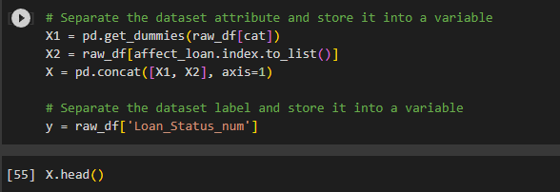
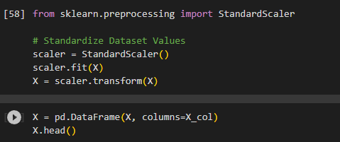
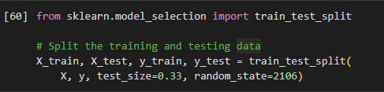
Label Encoding
In this step, we do one hot encoding for the categorical variables.
Data Scaling
We use Standard Scaling for the data transformation.
Split Dataset
We split the dataset into train and test data resulting into 312410 train data and 153875 test data.

Slide 27
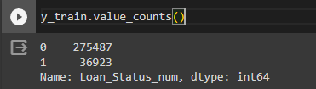
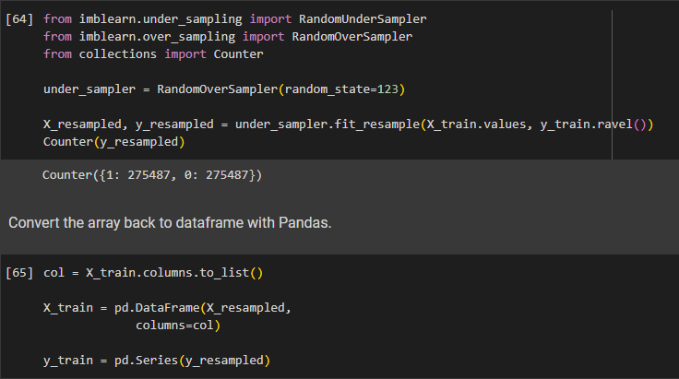
Evaluating Dataset Imbalance
We can see that the response values are very imbalance.
Since we have a large amount of data, which is more than >10.000 data, we can use under-sampling technique to address the imbalance in datasets.

Slide 28
Machine Learning
Model Training

Slide 29
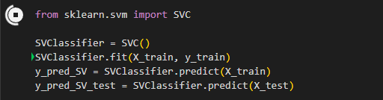
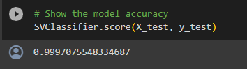
Support Vector Classifier Training
Model Evaluation
An accuracy of 0.9997 (99.97%) in classifying borrowers as "Good Loan" or "Bad Loan" is an exceptionally high accuracy rate. It suggests that the model is performing very well on the given classification task.

Slide 30
Project
Results
99.97%
Model Accuracy

Slide 31
Thank you!
There are still many more that can be improved within this project, so please don’t hesitate to reach me out in:
LinkedIn : Intan Citra Phonskaningtyas
GitHub : intancitra

